Slide 1
Life Transitions: Easing Into Parenthood
Team: #7
Team Name: The Seven
Team Members: Mehroos Ali, Soumadeep Basu, Mary Grace Kozuch, Sudarshan Athreya Suresh

Slide 2
POV & Target Users
We met a 25 year old father to a 1 year old son who works as a Biomedical engineer remotely allowing him to be with his son all day long.
We were surprised to know that although parents are overjoyed and grateful about parenthood, they acknowledge that they had to sacrifice a lot of hobbies and passions which were important to them.
We wonder if this means, parents struggle to prioritize themselves and want to explore their passions after parenthood but do not have the time or means to do so.
It would be game-changing to provide ways to help them actively engage with their hobbies without affecting their duty as a parent.
Target Users: New parents experiencing the transition into parenthood and a desire to reconnect with their personal hobbies while embracing their new role with their child.

Slide 3
Tasks
Simple: Choosing your hobbies and adding events / routines to your calendar based on interests.
GOAL: User wants to add/track their personal hobbies and goals.
Moderate: User can strike off or mark items/events on their schedule as done/completed as and when they finish. Once they do so, they get offered various incentives and rewards.
GOAL: User gets incentives to ensure that they stay on track to pursue hobbies/interests while still caring for their child
Complex: User can add a child and associated information about the child's schedule and habits. Once they do so, the app generates a custom schedule that ensure that pursuing goals does not mean neglecting the child in the users case.
GOAL: User needs to integrate their old life with their new schedule for the baby

Slide 4
Heuristic Violations & Fixes (*)

Slide 5
HE | Problem Description | Suggestion to Fix | Addressed | Comments
H1: Visibility of System Status (Severity: 3)* | When you completed a task, after clicked completed, it will be cross out. But they are remaining in the page. If you have multiple tasks that longer than your screen, You have to scroll down to check any other tasks have been finished or not. | Create separate page to store finished tasks. Or show unfinished task on the top, finished task on the bottom. | yes | For a particular day, the completed tasks will now show at the bottom and the unfinished tasks at the top. Creating a separate page to store finished task will require major restructure of the code for calendar and task display.
H3: User Control and Freedom (Severity 3)* | No option to edit child details | People will make mistakes while adding details. It is imperative to provide an option to modify them. | yes | Added remove option on child card. To edit a child details, the user needs to remove the child and add a new child details.
H3: User Control & Freedom (Severity:3)* | If you type the wrong name or birthday, you cannot delete that profile | add a delete function for this page | yes | Added remove option on child card. To edit a child details, the user needs to remove the child and add a new child details.
H3: User control and freedom (Severity: 4)* | User are not able to delete the child instance once created. Users are not able to update the name, age and Gender once the Child instance is created. | Users should be able to delete and update the child instance. | yes | Added remove option on child card. To edit a child details, the user needs to remove the child and add a new child details.

Slide 6
HE | Problem Description | Suggestion to Fix | Addressed | Comments
H4: Consistency and standards (Severity: 2)* | There is no back button given in any screen. The user has to click on the three buttons for navigation and click on Home screen every time they want to go from one screen to the Home page. | Providing a back button on each screen would make the app more consistent and easier for the user to navigate too | yes | Added a home button on the header of hobbies, hobbies events, rewards, children and children task screen. This will make easier to transition to home screen from other screens. Since add hobby and add child screens are modals, there is no support in react native on adding a button on the header of these screens.
H4: Consistency and Standards (Severity:2)* | There is no validation for age of the baby while adding the new entry. | Implement some validations for the age of the baby. | yes | Redesigned the Add Child Popup to include field validations.
H5: Error Prevention (Severity:3)* | In the calendar page, I can add an activity for yesterday and don’t get an error | pop up an error message if add an activity for yesterday | yes | Added validation to prevent adding children events which are past the system time.
H5: Error prevention (Severity: 4)* | Able to add the events in the calendar for the dates before the current date. | User should not be able to select events before current date. They should be displayed error when adding events before current date. | yes | Added validation to prevent adding children events which are past the system time.
H5: Error prevention (Severity: 4)* | Not able to validate the information like Name, Age and Gender when adding a child. | The system should be able to validate the information entered in the form fields. | yes | Redesigned the Add Child Popup to include field validations.

Slide 7
HE | Problem Description | Suggestion to Fix | Addressed | Comments
H8: Aesthetic and Minimalist Design (Severity 1)* | Home screen is a bit way too minimalistic. I feel like it is lacking at least a welcome message after logging in. Adding a self-care tip of the day to the home screen could be another option to make user feel welcome. Right now the home screen looks too empty. | add a welcome message to the home screen of the app after the login. | yes | Added a welcome message when the user login each time. This message will be displayed only once per login.
H9: Error Recovery (Severity 3)* | Generic error message rather than a targeted one! In case there is any issue with email and password in the login screen, a generic error message is displayed on the screen! | More specific error messages (Email is blank, password is blank, Incorrect Password, incorrect email format) will be better for a good UX | yes | Added validations on the login screen to get more specific error messages.
H10: Help and Documentation (Severity 3)* | As a new user, the home screen confuses me. Same goes for other pages : I can add a child, add a hobby, but how do they all relate ? What is the purpose of the application and how do these details (child and hobby info) help ? | There needs to be some sort of guidance to help people understand the features that the application can perform | yes | Added a help option on the home, children and parent screen to provide instructions for these screens.

Slide 8
Heuristic Violations & Fixes (Non-*)

Slide 9
HE | Problem Description | Suggestion to Fix | Addressed | Comments
H1: VISIBILITY OF SYSTEM STATUS (severity: 3) | Sometimes after clicking on complete option given in the alert box, the tasks on the calendar are not removed from the list or are not cancelled. Any indication to show the task is complete is not implemented in some cases. | Debugging the feature and adding a cancellation feature to completed tasks would help user understand what is going on in their task list | no | This is not a code issue but an existing react native calendar component issue (https://github.com/wix/react-native-calendars/issues/1589). The only work around will require to use async react native storage API which would require major code changes across the whole app to manage state using a different architecture.
H1: Visibility of System Status (Severity: 3) | The top bar, not matter is 16 or 17 or 18, all task from different days will show together | Only show the task on specific day. Like tasks created on 16th only show on 16th | no | This is again a default behavior of the react native calendar component and not something we can control easily from the code. There were no solutions found online as well.
H2: Match BETWEEN SYSTEM AND REAL WORLD (SEVERITY: 2) | A calendar has an option to view previous dates or go to previous dates. Here the calendar displays only a particular set of dates, and the user cannot navigate to any other place. | If not future, the past dates can be stored and shown to the user to help keep tabs on the tasks they performed earlier | yes | This feature is already available to the user. User can use the calendar knob to go to previous days to see past events. Instructions to do is added in the Help Tab.
H2: Match between System and the Real World (Severity:2) | You can see the timeline of the schedule is in the order of your previous schedule. It will make more sense if it’s in the order of time. | rearrange the activities based on the time | no | Sorting of activities based on completeness is added. Adding another sorting based on time will require to write complex logic for time string sorting in javascript.

Slide 10
HE | Problem Description | Suggestion to Fix | Addressed | Comments
H3: User Control & Freedom (Severity:2) | In the hobby page, you can see different categories of hobbies, but you can’t see how many events selected for each hobby. | add a summary for each hobby, like how many events you choose to attend | yes | Modified the hobby card to show how many events the user is attending.
H3: User Control & Freedom (Severity:1) | From the calendar page, you can see all activities have the same level of importance. However, in the real-life, something may have the most importance to others. Thus, you want to add some notes to it or maybe add an alarm clock for that activity. | add an alarm clock button, if you find this activity important | no | This is a good suggestion. Will require modification of data model for calendar events to include a field to mark importance. Adding an alarm on the event card will require research into react native alarm components and their integration with android phones. Also further modifying the events card might affect the overall text display on the card.
H3: User Control and Freedom (Severity: 1) | Sign up does not work. User is not able to sign up. | User is not able to sign up. Sign Up functionality should allow user to sign up with new credentials. | yes | Sign Up feature is added in the App.
H3: User Control and Freedom (Severity: 2) | On the calendar page the current date is pre-selected for each future and previous months. User is not able to deselect the preselected current date | Current date should not be preselected. In the image below the current date is 18 and you can see it is preselected for the future and previous months. | no | We do not know the root cause of this issue but seems like an issue with the react native calendar component. There were no working solution found online.

Slide 11
HE | Problem Description | Suggestion to Fix | Addressed | Comments
H3: User control and freedom (SEVERITY: 4) | The user cannot edit the name of added child or remove a new entry from the list of children in case of error in typing or entering wrong information. | A 'REMOVE' button or 'EDIT' option can be provided along with the feature present here | yes | Added remove option on child card. To edit a child details, the user needs to remove the child and add a new child details.
H3: User Control and Freedom (Severity:2) | There can be duplicate entries of the same baby while adding a “New baby”. The duplicate entries cannot be removed. | Do not allow duplicate entries or allow user to remove wrong entry for a baby. | yes | Redesigned the Add Child Popup to include field validations.
H3: User Control and Freedom (Severity:1) | Back Button not implemented in the hobbies section and it is difficult for user to navigate from there to other pages. | Implement a back button so that User can easily navigate away from this page. | no | Add Hobby screen is implemented as a pop up and not an actual screen from where user can go back using a back button. This would require creation of a additional screen for the stack. We feel the cancel button is good enough for the user to go back and navigate to other pages from there.

Slide 12
HE | Problem Description | Suggestion to Fix | Addressed | Comments
H4: Consistency and Standards (Severity 1) | Different color palette(background color and tile color) for rewards page as compared to the other pages on the app, which doesn’t look so great and unified with the app. | For better experience, I will recommend using same background color and tile color as on the other pages (rewards, children) | yes | Tile color and background color for the rewards page is modified to a brighter pink color to match better with the overall app color contrast.
H4: Consistency and Standards (Severity 1) | Sometimes completed tasks on the home screen calendar do not cross out. They would show up as crossed out after moving to another section and then returning to the home screen by selecting Home on the menu. | review the mechanism of crossing out the tasks on the calendar upon being marked as completed. It is nice to see the task to be crossed out right after being marked as completed as it gives a feeling of satisfaction to the user and is expected to be crossed out by most users. | no | This is not a code issue but an existing react native calendar component issue (https://github.com/wix/react-native-calendars/issues/1589). The only work around will require to use async react native storage API which would require major code changes across the whole app to manage state using a different architecture.
H4: Consistency and Standards (Severity 1) | In the Hobbies and Children sections the Add and Remove buttons look like plain black text on white background with no actual button outline. However, on the page where we add things scheduled for children, buttons for adding to calendar do have a button outline and color. | follow the same style of buttons and use maybe 2 colors which have enough contrast against the white background. | yes | Color of Add and Remove button is changed to blue to match better with the overall app color contrast .

Slide 13
HE | Problem Description | Suggestion to Fix | Addressed | Comments
H4: Consistency and Standards (Severity 2) | The standard for the current date highlighting on the digital calendars is outlining today’s date with the color circle. When I scroll through the app’s calendar I can see a similar date from other months being highlighted as well (not only November 20 is highlighted, but also December 20 and so on). It looks a bit confusing. | make only the current date of the current month marked as today’s date. | no | We do not know the root cause of this issue but seems like an issue with the react native calendar component. There were no working solution found online.
H4: Consistency and Standards (Severity: 1) | They use green color as the color of ‘date’ button. However, they didn’t use colors for all other buttons. It looks strange comparing to other buttons. | change the color from green to none color | yes | Color of the date button is changed to pink to match better with the overall app color contrast.
H4: Consistency and Standards (Severity:3) | Some events on the calendar show the wrong time associated with the event. For Example time for some events displays as 12:6 pm which should actually be 12:06pm. | We discussed about this and could be due to the light/dark feature of the development platform. Changing the mode might solve this issue. | yes | This was code issue which is fixed now and the time shows in proper format eg. 12:06 pm instead of 12:6 pm.

Slide 14
HE | Problem Description | Suggestion to Fix | Addressed | Comments
H5: Error Prevention (Severity 2) | No confirmation dialog box on clicking add button on the add child modal | It is always better to add a confirmation before adding details to a database, more so in case they cannot be edited later (which is true in our case) | yes | confirmation dialog box added on the add child modal.
H5: Error Prevention (Severity 4) | No validation on any field Add Child Popup page | There is no validation present which creates entries without any data as shown on the left. This needs to be fixed on priority | yes | Redesigned the Add Child Popup to include field validations.
H5: Error Prevention (Severity 4) | Date Field is not available while using normally on our phones, and like previous screen, no validations here as well. | This needs to be fixed on priority as without knowing what date we’re choosing, all future actions will be impacted. Also validations are very important to prevent spurious entries. | yes | Date Field is added on the Add Child task screen.
H5: Error prevention (Severity: 3) | User can enter same hobbies multiple time and if we try to delete one of the duplicated hobby both the duplicated hobbies gets deleted. | User should not be able to add multiple hobbies. They should be displayed error when adding same hobby. | yes | Added validation to prevent user from adding duplicate hobby.

Slide 15
HE | Problem Description | Suggestion to Fix | Addressed | Comments
H5: Error Prevention (Severity:3) | I can add child task on expired day | check the day is an expired day or not, if it is, required user set a valid time | yes | Added validation to prevent adding children events which are past the system time.
H6: Recognition rather than recall (Severity: 2) | Once user has marked the event as completed it does not show any confirmation to the user. The user has to reload the page to see the confirmation that he or she has marked the event completed. | Users be able to see the instantaneous update when he or she marks the event as completed on the calendar. | no | This is not a code issue but an existing react native calendar component issue (https://github.com/wix/react-native-calendars/issues/1589). The only work around will require to use async react native storage API which would require major code changes across the whole app to manage state using a different architecture.
H7: Flexibility and Efficiency of Use (Severity 1) | There is a lot of empty space on the home page for a new user | This can be leveraged to add some quick action CTAs or buttons to access tasks directly rather than finding them through the menu | no | The home screen is might look minimalistic when a new user logs in for the first time. As the tasks are added the screen will be filled. Adding quick CTA's would defeat the purpose of navigation with a drawer vs buttons on a home screen which was design decisions taken by the team.

Slide 16
HE | Problem Description | Suggestion to Fix | Addressed | Comments
H7: Flexibility and Efficiency of Use (Severity:3) | Everytime after you added a new task, if you want to go back to home page, the only way is to click <- to go back. Also, if you want to change different task, you have to go to home page, click the side bar. You have to click multiple time to go back to home page | Have the bar to help user jump to different page more easily (like the red part I draw on the image) | yes | After adding a hobby task or children task, user now has the option to navigate to home or other task screen immediately without pressing the back button.
H7: Flexibility and Efficiency of Use (Severity:2) | When you add hobbies, you must add the type of the hobby, then select event from that type of hobby. I think it can be simpler. | One event pages, put all events together, have filter function to find them easily. Then add event directly | no | This is a good idea. But the implementation would require considerable amount of research and major re-design of hobbies and events page.
H7: Flexibility and Efficiency of Use (Severity: 2) | All the event only show the day, time, location. The information is limited | Extend the event card, after you click the card, user can see the details of the event. Then decided whether they want to join it or not. | no | The event card is made generic to accommodate both hobbies and children events. Displaying any more info would require a redesign of the card in terms of size and overall display. Also displaying more info on the alert would make the alert more cluttered and would require design changes in terms of new functionality (event details, event joining) and old functionality (event delete, event complete).

Slide 17
HE | Problem Description | Suggestion to Fix | Addressed | Comments
H8: Aesthetic and Minimalist Design (Severity 1) | In the rewards section the rewards show up on light grey cards against the white background. Choosing a different color could help to create more contrast and give the cards more aesthetically pleasing look. Also, viewing the rewards page should give a user the feeling of satisfaction/gratification for their effort in taking care of kids and performing self-care. So, I think cards need to have a brighter color. | change the color of rewards cards to a brighter one. | yes | Color of rewards card is changed to pink to match better with the overall app color contrast.
H8: Aesthetic and Minimalist Design (Severity:1) | Normally, coupon will have an expired date | add an expired date | yes | coupon now show expiry date also.
H8: aesthetic AND minimalistic design (SEVERTIY: 2) | The Login text and button are not visible, there is low contrast between text and color of the button. This will make it difficult for the user to see what the button's function is. | Use a lighter color for the button | yes | We feel that the deep pink color of the login button matches well with the light pink input fields on the login page. Changed the font color on the text to white for better visibility.

Slide 18
HE | Problem Description | Suggestion to Fix | Addressed | Comments
H8: Aesthetic and Minimalistic Design (Severity:2) | In the Hobbies Section, the select and remove options are not clearly seen. The user can be confused due to that. | Make the Select and Remove buttons a bit eye-catching and visible to the User. | yes | font size for Select and Remove button is bigger now.Also the color of these button is changed to blue.
H8: Aesthetic and Minimalistic Design (Severity:1) | The email and password text boxes were perceived as buttons at first. The email and password textboxes are a bit confusing. | Please modify the textboxes so the User will not be confused. | no | The team does not think it is confusing for the user to distinguish the email/password as a input or button.
H8: Aesthetic and Minimalist Design (Severity: 1) | The card has padding on the top, but no padding on the bottom. Select and Remove on the bottom of the card | Add padding on the bottom, move select and remove button up | no | The styling for the card is tightly coupled which is making it hard to add padding for the select and remove buttons.
H9: ERROR RECOVERY (SEVERITY: 3) | The calendar feature does not give any instruction or message when a date prior to that of the current date is selected. The UI shows both dates as selected and no other information as to what is happening in the app. | Giving an alert or a detailed error message about the status of the task in the application would help user understand their status in the application | no | This is a default behavior in the react native calendar component. As such there is no fix found online and would require analysis on the calendar components code.
H10: Help and Documentation (Severity:1) | There is no help or documentation in the web-app for help in troubleshooting. | Add a Help Tab which will help the user troubleshoot if he/she comes across any problems. | yes | Added a help option on the home, children and parent screen to provide instructions for these screens.

Slide 19
HE | Problem Description | Suggestion to Fix | Addressed | Comments
H10: Help and Documentation (Severity 2) | I think it would be helpful to have a section with the general overview of the app functionality. However, the app is fairly simple and straightforward and task-related prompts are in place (I saw the prompt to check the calendar on the home screen after adding a hobby related event to my schedule) | add a section with a brief overview of app’s functionality | yes | Added a help option on the home, children and parent screen to provide instructions for these screens.
H10: Help and Documentation (Severity 2) | When a new child is added (I added Anna) to the list of children, there is no option to customize the picture of a child. Only a random child picture is used on each of the babies’ cards. A bit more experienced user will highly likely want to customize the picture. | add an option to upload user baby’s picture to use for the Children section. | yes | Redesigned the Add Child Popup to include an option to upload baby's picture.
H10: HELP AND DOCUMENTATION (SEVERITY: 1) | There is no place where the user can go in case of any issues faced by them, or refer to a document where an option to contact the admin or FAQ section is given | The application can have an option of About us or document the goals of the application at some place to make user's queries go away quickly | yes | We have added a Help banner on Home, Hobbies and Children page. This should give enough instructions to use the app correctly. Plus we have added the contact email to reach in case of any issue.

Slide 20
Other usability issues
There were no major usability issues found during demo or recommended by the teaching staff.
Minor usability issues were fixed by adding home button on various screen for easier navigation.
Also it has been made sure there is proper validations and error preventions everywhere to prevent wrong user actions.
Notes:
A live version of the prototype for evaluation. URL must work at the time your assignment is graded. If there are specific requirements (e.g., user’s credential, browser, or device settings), include them here

Slide 21
Prototype
Target Device: Mobile UI (Android)
APP LINK: https://drive.google.com/file/d/1FYkug8s3NzlbYKVf08wc6HCR4r5NrrG2/view?usp=share_link
PROJECT CODE: https://github.com/mehroosali/Muy-Feliz
Notes:
A live version of the prototype for evaluation. URL must work at the time your assignment is graded. If there are specific requirements (e.g., user’s credential, browser, or device settings), include them here

Slide 22
Libraries and Frameworks
React Native - https://reactnative.dev/
React native is a JavaScript framework used for building native user interfaces for android and iOS devices. Our main code was written in javascript using react native framework features.
React - https://reactjs.org/
React native is a JavaScript framework used for building user interfaces for web development. This framework is used to support react native for native app development. Its features and style of writing code in terms of reusable components were incorporated into our App.
NodeJS - https://nodejs.org/en/
It is a JavaScript runtime environment that provided a runtime engine for our app. It also provided a package manager called npm which was used to set up our project and install all the external dependencies the app needed.
Android Studio - https://developer.android.com/studio
It is an IDE used for Android app development. It also provides an Android phone emulator for the laptop. We used Android studio to write and manage our code and various JS files. Also, the emulator was used to run, debug and test our developed code.
Expo - https://expo.dev/
Expo is an open-source platform for making universal native apps for Android, iOS, and the web with JavaScript and React. We used it to deploy and build an APK file for our app.
Builder X - https://builderx.io/login
BuilderX is a browser-based design tool that codes React Native. We used it to design the app layout for screens such as launch, parent, child, and add child tasks.
GIT - https://git-scm.com/
Git was used for code collaboration among team members. Our code repository was set up on GitHub.
React Native libraries used:
redux - used for managing state within the application and passing data from one screen to another.
react-navigation - used to set up and configure navigation between different screens.
react-native-calendars - provides the calendar component used in the home screen.
react-native-date-picker - provides the date picker component used in the add child task screen.
React-native-paper - provides the card component used in the home and event screen.
urrid - generates a random unique id for each task, hobby, and baby.
react-native-image-picker - provides the image picker component used in selecting image in the signup and add child page.

Slide 23
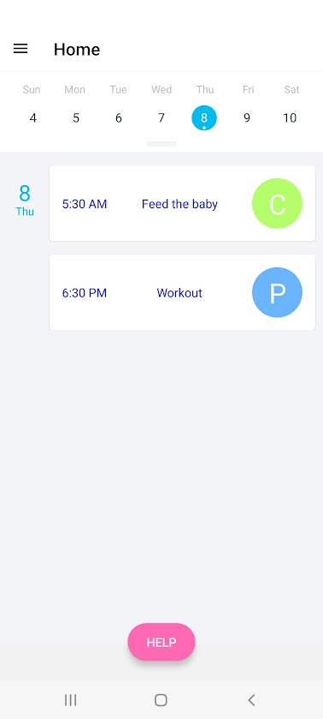
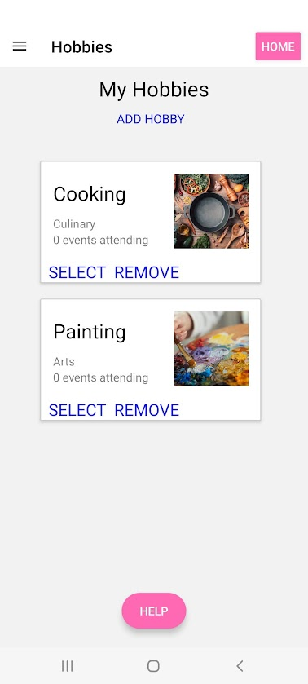
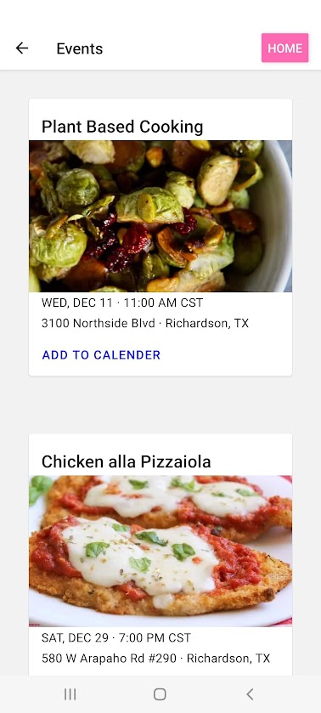
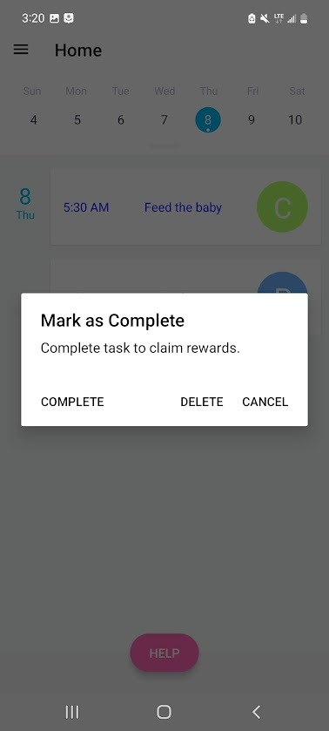
Screenshots

Slide 24
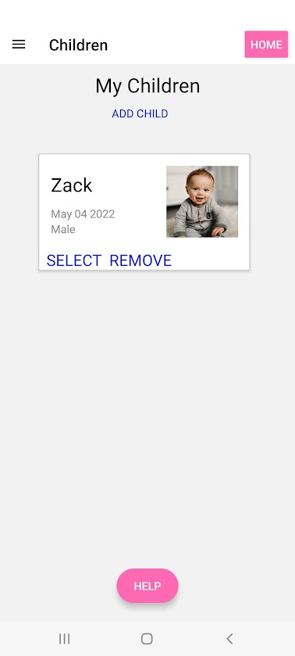
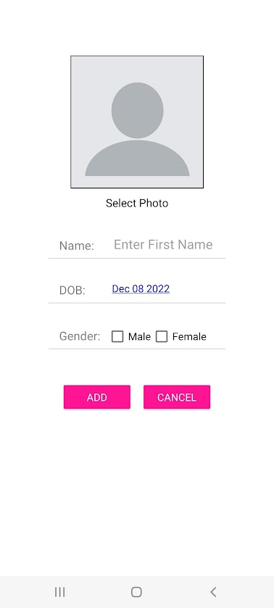
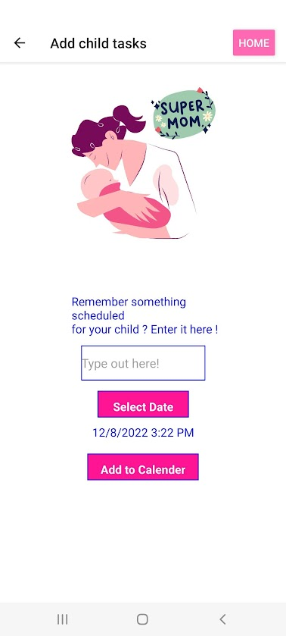
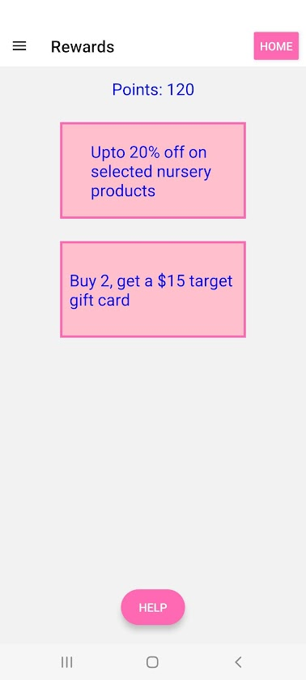
Screenshots

Slide 25
Quality Arguments
Both personal and child schedule in one place
This application presents the novel idea of combining a new parents personal hobbies and activities with their new very important role of taking care of their child. Through our market research we found that this combination is not available in other applications currently available.
Connected with events around you in your interest area
This application provides an easy to view list of events in the users area related to their interests. Through interviews, this feature was requested by new parents as a way to easily continue aspects of their life that they enjoyed prior to becoming a new parent.
Variety of hobbies
The hobby selection process provides a variety of different hobbies in different interest areas. This allows parents to find both old and new hobbies to expand their lives.
Incentivized personal care
The rewards aspect works to give parents some incentive to put time into themselves as well as their children. This is important as many parents find their most immediate effort goes to their children and it is hard to find time or energy for themselves. This form of activity tracking can help to push parents to remember their own needs as well as their children’s. Additionally, the rewards tend to be child based which aim to take some of the financial pressure off of new parents.
Notes:
Make convincing arguments for what makes your interface “great”. Depending on your interface, you may focus on different aspects: neat features, visual design, usability, novel UI components you designed, etc. This is your chance to convince us that what you created is a high-quality user interface.

Slide 26
Quality Arguments
Simple buttons for quick use
Throughout the day, many new parents have only one hand available for use while holding kids or preparing food. Therefore, the application aims to use large easy to find buttons for hobby addition and task completion to make use with one hand easy.
Easy to read calendar
The home page shows the users calendar, this is essential as it is the most accessed page of the application. It was designed to be simple, quick, and easy to read and use for busy parents.
Open-ended child activity tracking
The use of a text box for tracking children’s activities allows for parents to use this feature however they would like. It could be used to track large events such as “First day crawling” or small daily events such as “Bottle Fed 1 Ounce”. Parents can add as much or as little detail as they would like, thus catering to all types of parents and all times in a child’s life.
Faster, Modular, Responsive, Consistent and Flexible UI
The UI is designed for faster response to every action performed by the parents weather it is managing their children or hobbies. The UI is consistent and provide easy of use keeping parents happy and motivated when taking care of themselves or their children.
Notes:
Make convincing arguments for what makes your interface “great”. Depending on your interface, you may focus on different aspects: neat features, visual design, usability, novel UI components you designed, etc. This is your chance to convince us that what you created is a high-quality user interface.

